Slide 1
Unsupervised learning

Slide 2
What is Unsupervised learning
The AI system is presented with unlabeled, uncategorized data
Systems algorithms act on the data without prior training
There are two types
Clustering
Association

Slide 3
Clustering
A type of unsupervised learning
Draws references from datasets consisting of input data without labeled responses
Purposes
Find meaningful structure
Explanatory underlying process
Generative features
Groupings inherent in a set of examples
Types
Density based methods
Hierarchical methods
Partitioning methods
Grid based methods

Slide 4
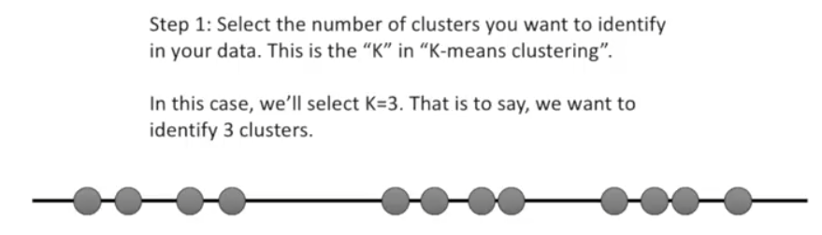
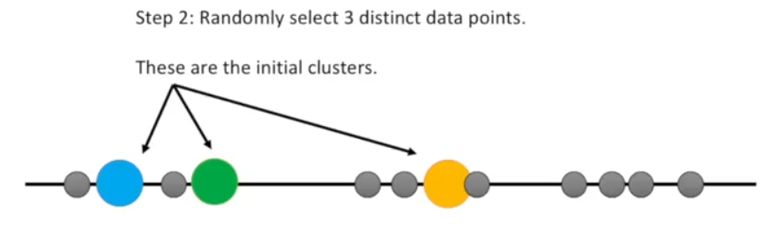
K means clustering

Slide 5
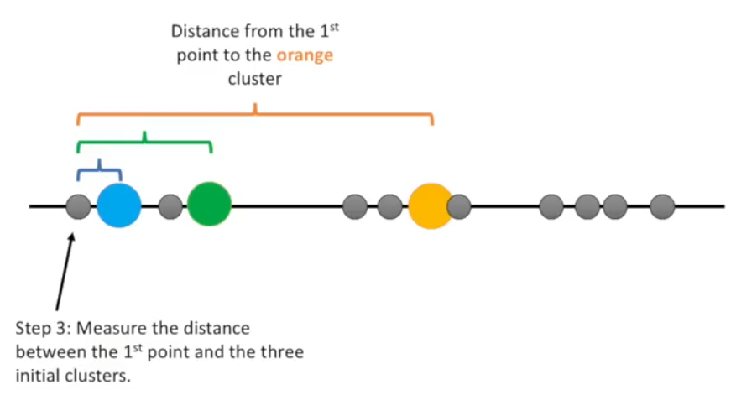
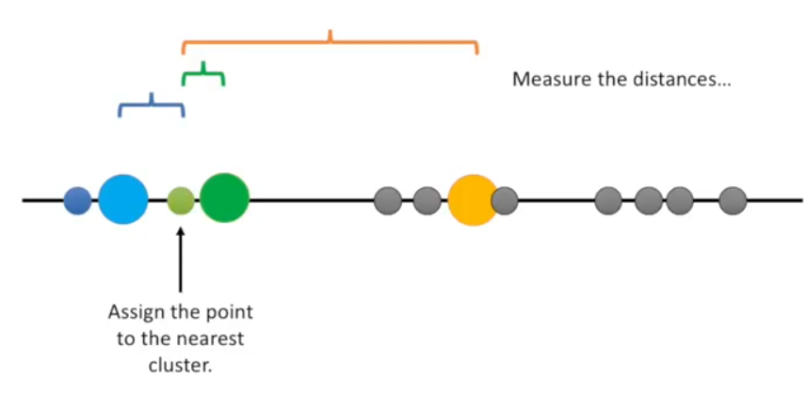
Contd..

Slide 6
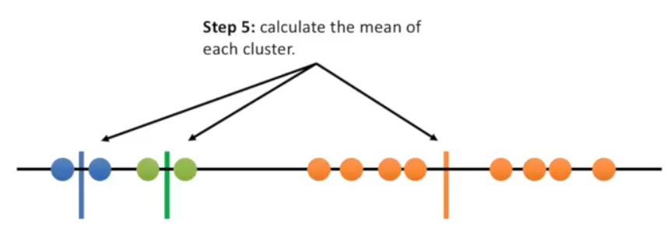
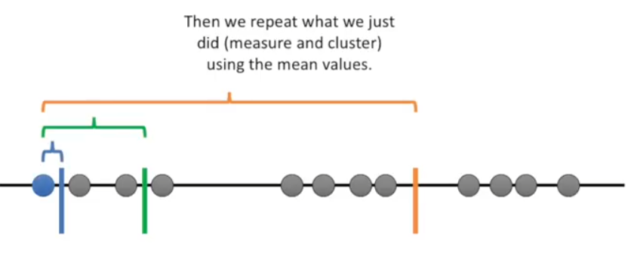
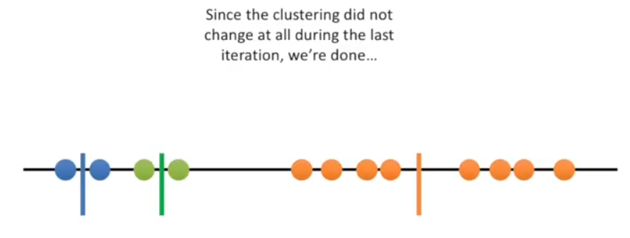
Contd..

Slide 7
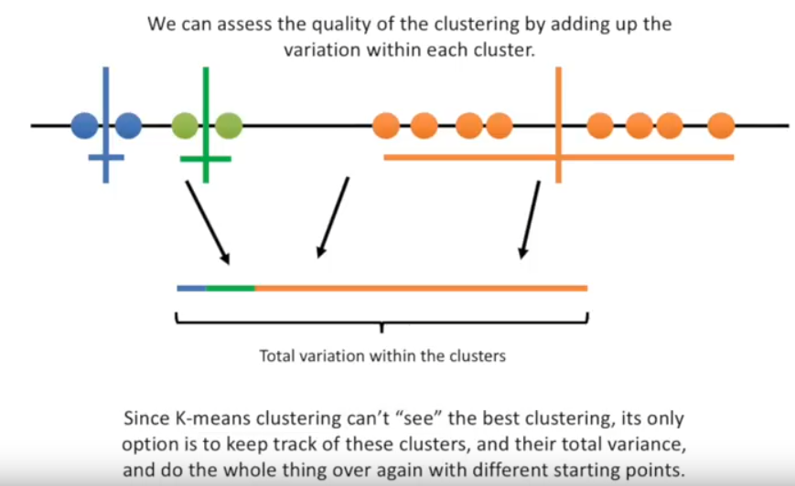
Contd..

Slide 8
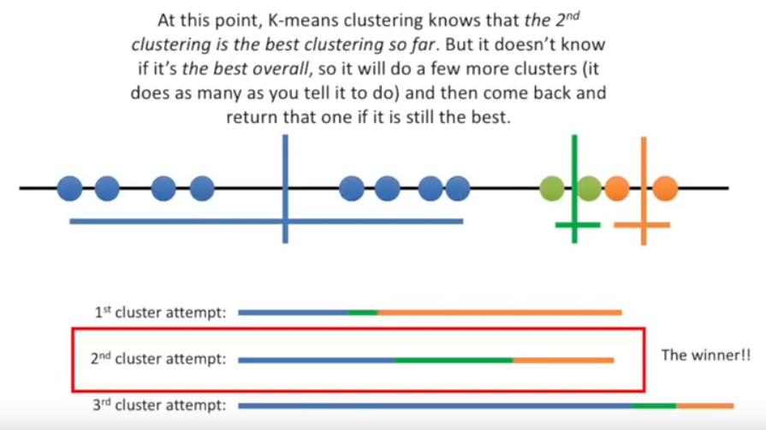
Contd..

Slide 9
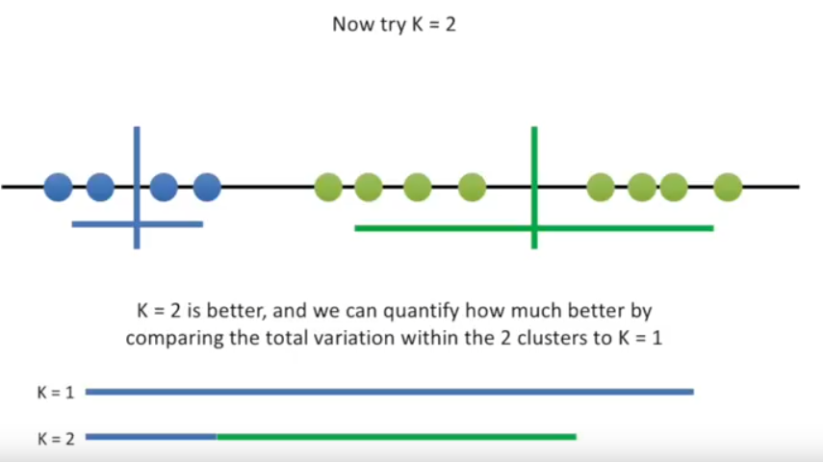
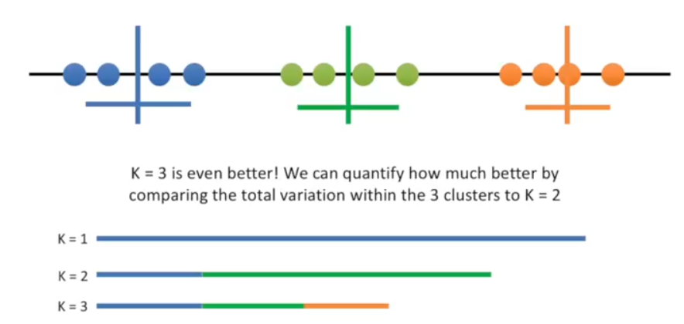
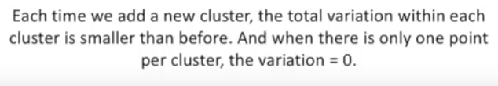
How to choose K

Slide 10
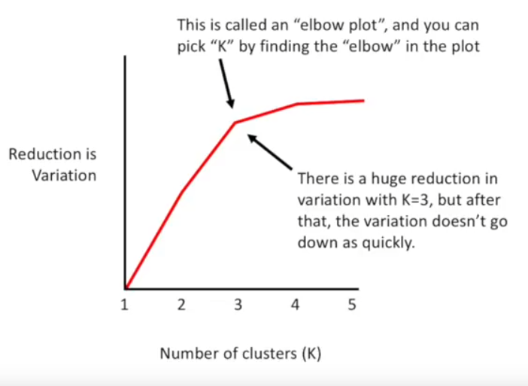
Contd..

Slide 11
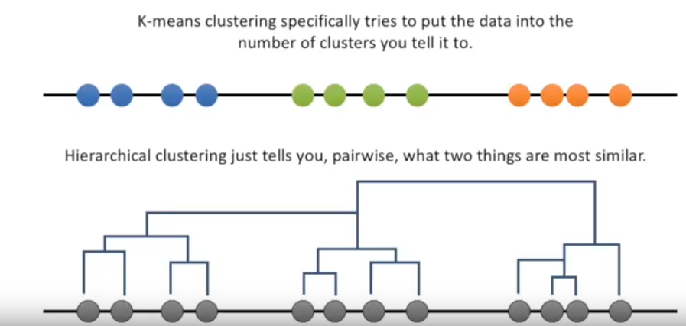
K means vs hierarchical clustering

Slide 12
mixture model
Recall two types of clustering
Hard clustering
Soft clustering
Hard clustering
Clusters donot overlap
Elements have a binary membership
Soft clustering
Clusters may overlap
Strength of association between clusters and instances
Mixture model
Probabilistic grounded way to do soft clustering
Each cluster a generative model (Gaussian or multinomial)
Parametes (e.g. mean / covariance's are unknown)
EM algorithm allows to find those parameter values

Slide 13
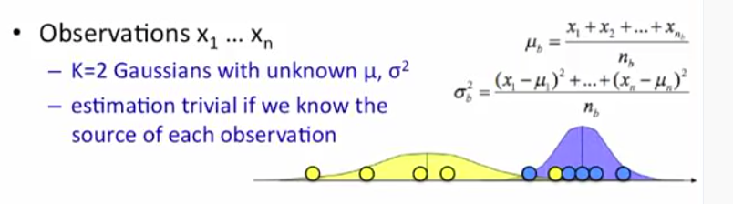
Mixture model in 1D (with labels)

Slide 14
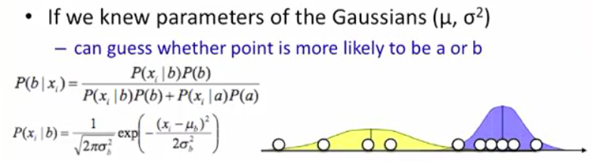
Mixture model 1 D – source unknown but parameters known

Slide 15
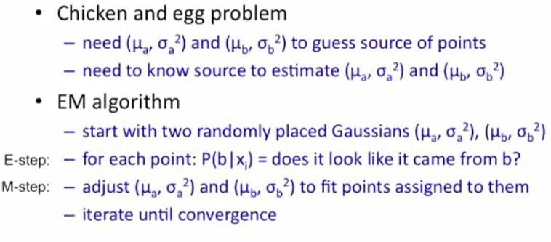
EM algorithm

Slide 16
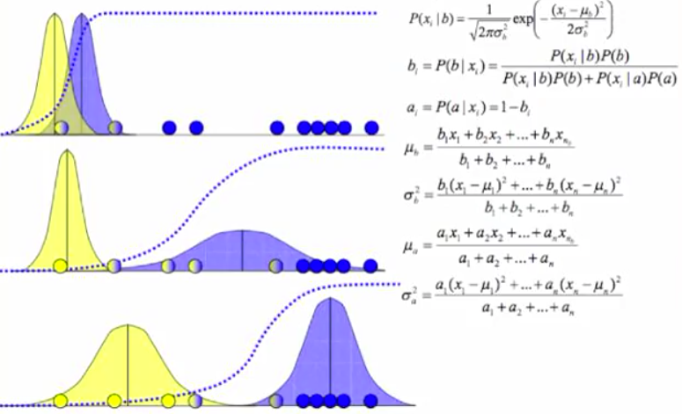
EM – 1d example

